Slide 1
Human Vs Machine
B’ground
ETL
ML
Can you tell if you are over or underweight?
Demo
Sum up
ENTER
Data

Slide 2







Table of contents
B’ground
ETL
Background
Extract Transform Load
ETL process in our data - christian
Machine Learning Modeling and Prediction
ML
Project background and objectives - rosa
Difference of ML models - ash
Demo
Demonstration
What we learn
Sum up
The result - patty
The pain, the joy and the experience! - dhiren
Data

Slide 3
Who are we!
B’ground
ETL
ML
Ash
Dhiren
Patty
Christian
Rosa
Thu
Fri
Wkd

Slide 4
““Obesity is absolutely a disease that requires a range of interventions and medical management… People may say ‘just eat less, have will power’ but they just don’t understand that simply does not work for many people..”
-Alfonso Toquati MD, MS
B’ground
ETL
ML
Demo
Sum up
Data

Slide 5

01
Background
B’ground
ETL
ML
Demo
I think I’m on normal weight… (am I?)
Sum up
Data

Slide 6
What classify as obesity?
B’ground
ETL
notes
A BMI of 25.0–29.9 is classified as overweight but not obese, while a BMI of 30.0 or over is classified as obese. A BMI of greater than 35.0 is classified as severely obese.
Individuals developing signs of weight gain or obesity are also at a risk of developing serious illnesses such as type 2 diabetes, respiratory problems, heart disease and stroke.
ML
Demo
Sum up
Data

Slide 7
approach
B’ground
ETL
Identify data sources and dependency
Collect and clean trajectory data
Applying machine learning algorithms (decision tree, Random forest, XGBoost)
Comparative analysis
ML
Demo
Sum up
Data

Slide 8
And then….
B’ground
ETL
ML
Demo
Create charts and visualisation using tableau
Customise HTML for final application
Deploy to heroku
Sum up
Data

Slide 9
02
ETL
B’ground
ETL
ML
Demo
Extract- Transform- Load
Sum up
Data

Slide 10
Our flow
B’ground
ETL
ML
Demo
Sum up
Data

Slide 11

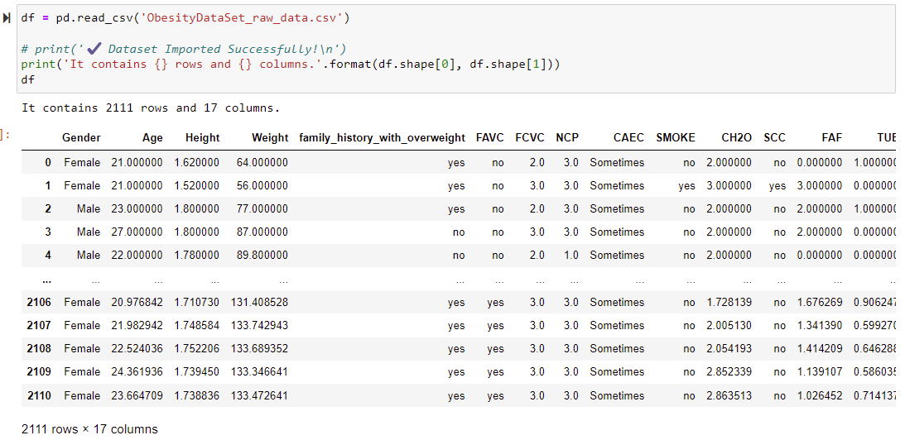
A PICTURE ALWAYS REINFORCES THE CONCEPT
B’ground
ETL
ML
Demo
Sum up
Data

Slide 12
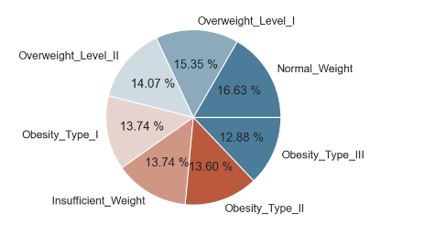
Base on our dataset…
B’ground
ETL
21,8%
ML
34,6%
32,7%
Demo
10,9%
Sum up
Data

Slide 13
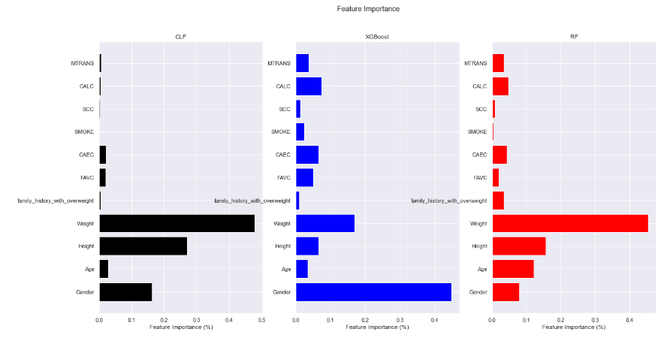
Feature importance..
B’ground
ETL
21,8%
ML
34,6%
32,7%
Demo
10,9%
Sum up
Data

Slide 14
03
ML
B’ground
ETL
ML
Demo
How we drill: test and train the data into machine learning algorithms
Sum up
Data

Slide 15
Infographics
B’ground
ETL
87.71%
Decision tree
ML
Machine learning
94.86%
Demo
XGbooster
82.36%
Random forest
Sum up
Data

Slide 16
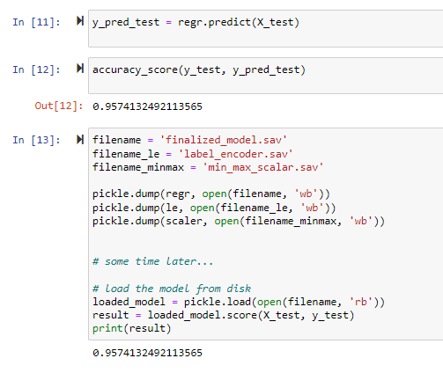
How we “train” the dataset into ML
B’ground
Using XGBOOSTER model - pick any random state
Test 30% Train 70%
ETL
ML
Demo
Sum up
Result: 95% accuracy !
And from there, we test our data.. And ready for….
Data

Slide 17
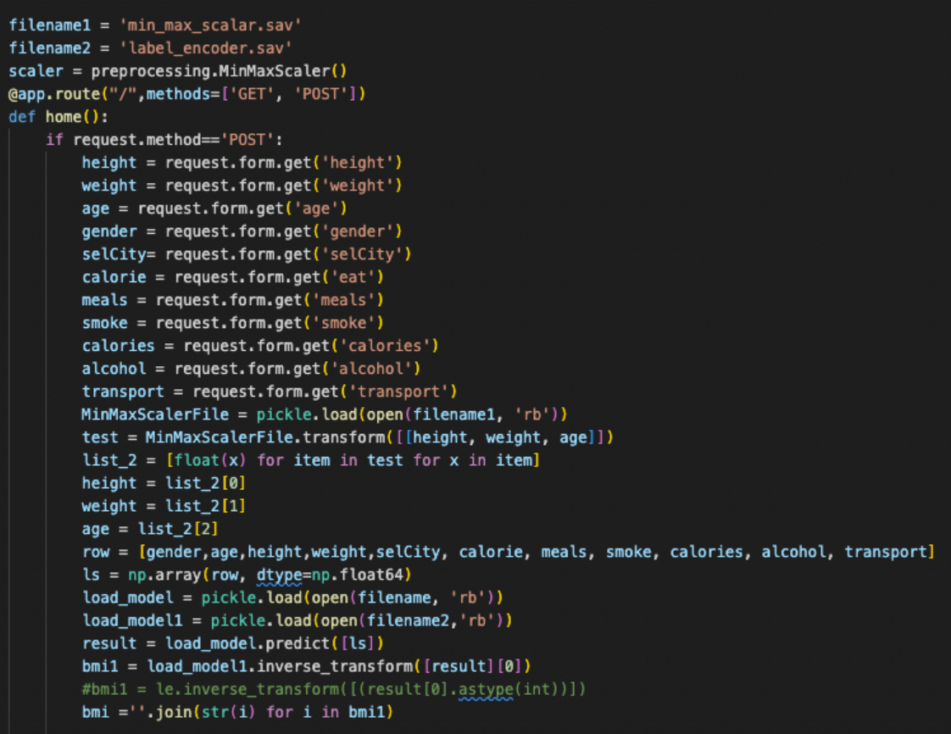
How we input the data into our model
B’ground
Using the Get request and then Post request linked to html file
ETL
ML
Demo
Sum up
Data

Slide 18
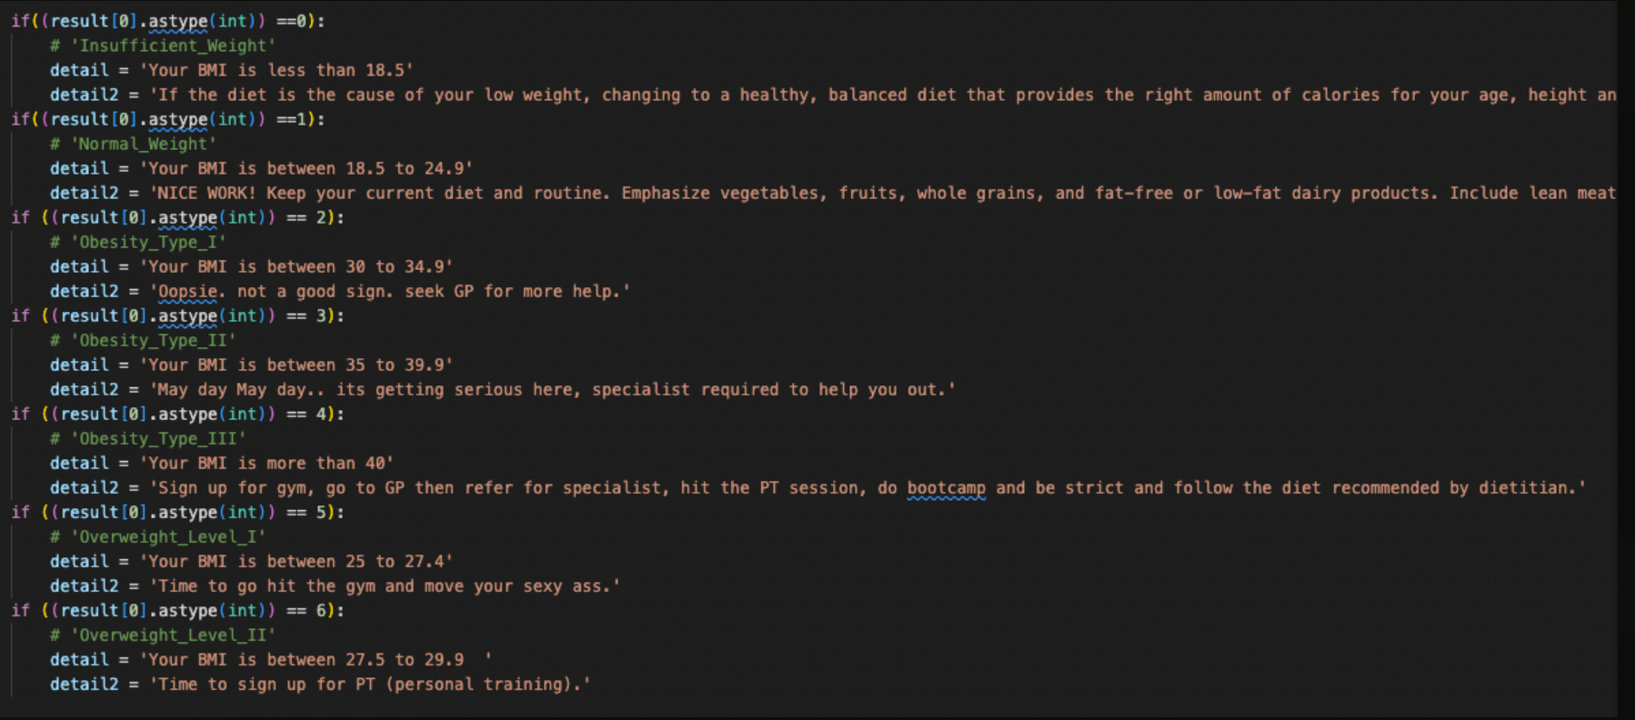
How we classify the result..
B’ground
ETL
ML
Demo
Sum up
Data

Slide 19
04
Demo
B’ground
ETL
ML
Demo
This is the drill…!
Sum up
Data

Slide 20

Demonstration..
B’ground
ETL
ML
Demo
Sum up
Data

Slide 21
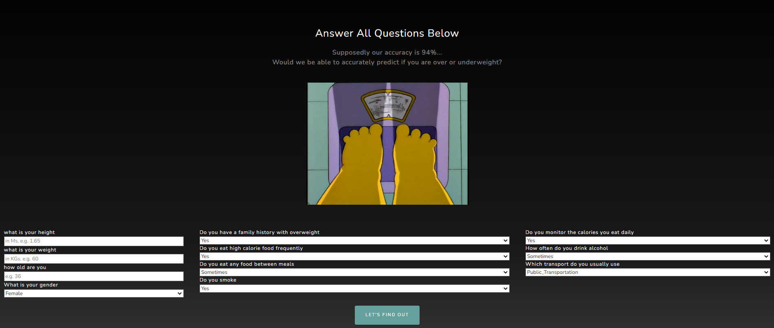
The question..
B’ground
ETL
ML
Demo
Sum up
Data

Slide 22

The verdict..
B’ground
There are 7 category base on the result:
ETL
“overweight 1”
“normal weight”
“under weight”
“obese weight 3”
“obese weight 2”
“obese weight 1”
“overweight 2”
ML
Demo
Sum up
Data

Slide 23
B’ground
Under weight
normal
over weight 1
over weight 2
ETL
When your BMI
Between 18.5 -24.9
When your BMI
Between 27.5-29.9
When your BMI
less than 18.5
When your BMI
Between 25-27.4
ML
Obese 1
Obese 2
Obese 3
When your BMI
Between 35-39.9
When your BMI
Between 30-34.9
When your BMI
Over 40
Demo
Sum up
Link here if you want to test it out yourself!
Data

Slide 24
05
Sum up
B’ground
ETL
ML
Demo
What we learn so far…
Sum up
Data

Slide 25
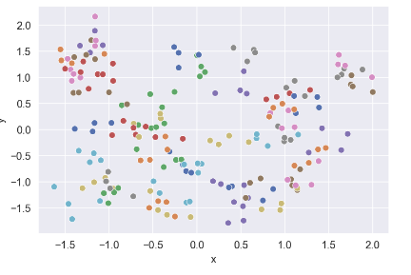
Previous dataset we pick…
So we learn from our mistake…..
B’ground
ETL
Always check the distribution of your dataset
before we going into machine learning prediction
We have tried to use every possible way to improve our accuracy by performing: normalization, standarisation, VIF (variance inflation factor) and Log transformation
ML
Demo
But the result still not improve….
Sum up
Data

Slide 26
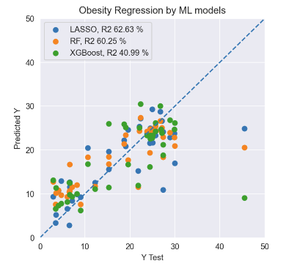
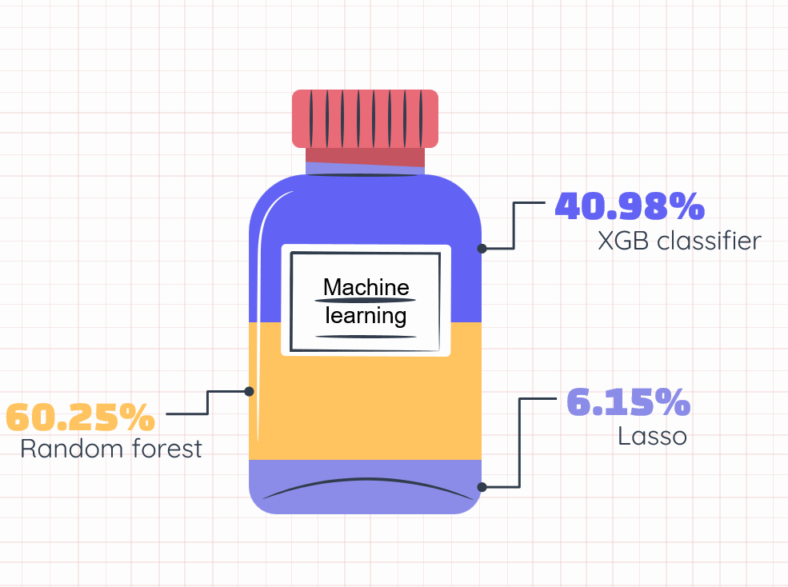
OBESITY vs Country
B’ground
The snapshot on our accuracy level
ETL
ML
You can replace the image on the screen with your own work. Just delete this one, add yours and send it to the back
Demo
Sum up
Data

Slide 27
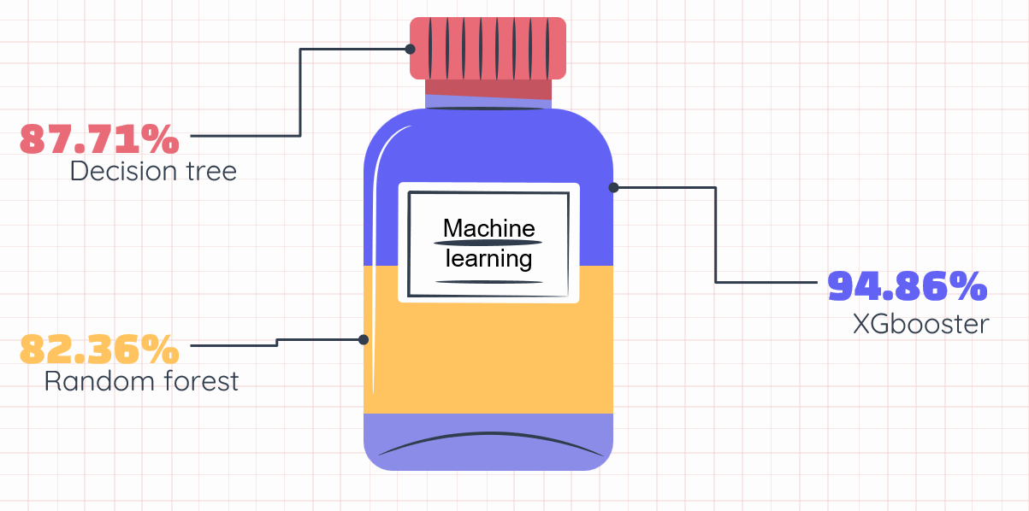
With Akashfu knowledge and wisdom..
B’ground
We finally switch to different dataset and …. Voila! From 40% accuracy, we get 90% accuracy..
ETL
To sum up!
94% accuracy
ML
Classification in ML will have higher accuracy in comparison to continuous variable dataset
The “bigger” the better (in data world)
Demo
We also recognise some of limitation including:
Geographical limitation in this data source (survey only conducted in certain countries: Mexico, Peru and Colombia)
Feature importance in this dataset is bias towards the weight of survey participant rather than other features
Sum up
No time stamp when survey is conducted
Unknown to which benchmark the definition of ‘overweight 1, 2, obese 1, 2, 3, normal and underweight’ use.
Data

Slide 28
06
Data set
B’ground
ETL
ML
Demo
Where do we pick our dataset
Sum up
Data

Slide 29
Resources..
B’ground
OUR GITHUB and tableau
ETL
DATASET
Link here
Link here (github)
Link here (tableau)1
link here (tableau)2
Link here (tableau)3
ML
Demo
Additional resources
Our Heroku link
Link here
Link here
Sum up
Data

Slide 30
YOURS TRULLY..
B’ground
ETL
 | Ash Tao
 | Christian Adiputra
 | Patty
 | Dhiren Patel
 | Rosa
ML
Demo
Sum up
data

Slide 31
THANKS!
Do you have any questions?
youremail@freepik.com
+91 620 421 838
yourcompany.com
Please keep this slide for attribution
UPLOAD

